Slide 1

KISS Agent Framework
Keep It Simple, Stupid
"Everything should be made as simple as possible, but not simpler." — Albert Einstein
Koushik Sen • ksen@berkeley.edu

Slide 2
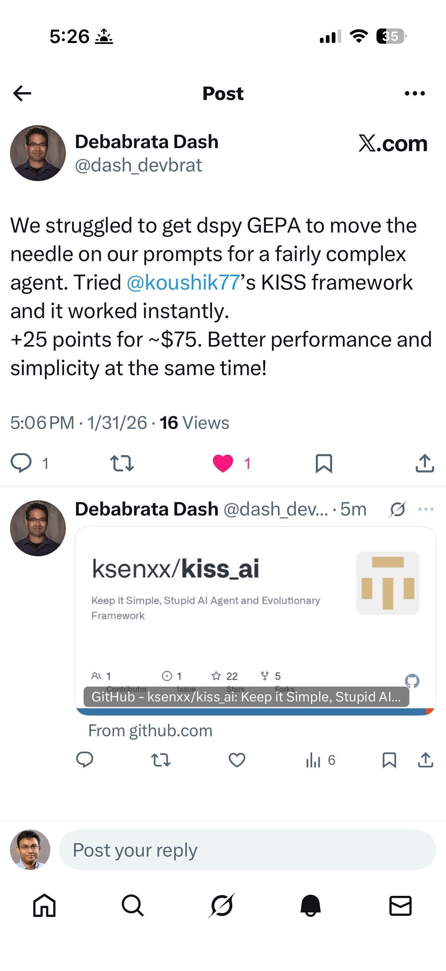

Slide 3
The Problem with AI Agent Frameworks
• Frameworks loaded with abstractions on top of abstractions
• Configuration files that rival tax forms
• Dependency trees that make node_modules look tidy
• Complex learning curves that burn enthusiasm
What if there was another way?

Slide 4
Enter KISS
A lightweight agent framework implementing a ReAct loop for LLM agents
Core Philosophy:
Simple Architecture: Clean, minimal core
Model Agnostic: Multiple LLM providers
Native Function Calling: Seamless tool integration
Just Python: No special DSLs or config files
Evolutionary algorithms
Create and optimize agents for long-running tasks

Slide 5
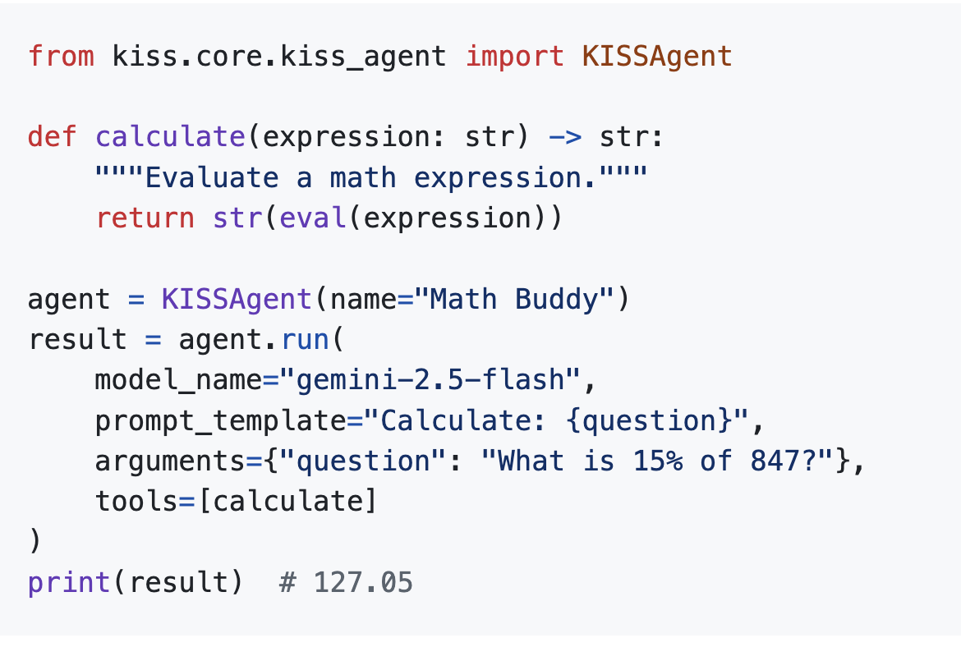
Your First Agent in 30 Seconds

Slide 6
The ReAct Loop Architecture
┌─────────────┐ ┌─────────────┐ ┌─────────────┐
│ Prompt │ ──► │ LLM │ ──► │ Action │
│ (User) │ │ (Reason) │ │ (Tool) │
└─────────────┘ └─────────────┘ └──────┬──────┘
▲ │
│ ┌─────────────┐ │
└────────────│ Observation │◄───────────┘
│ (Result) │
└─────────────┘
Reason → Act → Observe → Repeat until finish()

Slide 7
What Makes This Special?
No Annotations. No Boilerplate. No Ceremony. Just intent.
• Native function calling from LLM providers: accurate and fast
• Python functions become tools automatically
• Type hints become schemas
• Docstrings become descriptions
• Everything just works!

Slide 8
Framework Features
Core Features:
Simple Architecture
Multi-Agent Systems
Native Function Calling
Docker Integration
Trajectory Tracking
Budget Monitoring
No async/await
Advanced Features:
Agent Evolution (Pareto)
GEPA Prompt Optimization
KISSEvolve Algorithm Discovery
Basic in-memory RAG Support
Multiprocessing
Web Visualization

Slide 9
Supported Models
OpenAI:
gpt-4.1, gpt-4o, gpt-5, gpt-5.2
Anthropic:
claude-opus-4-5
claude-sonnet-4-5
claude-haiku-4-5
Google Gemini:
gemini-2.5-pro
gemini-2.5-flash
gemini-3-pro-preview
Together AI:
Llama-4-Scout/Maverick
Qwen3 series
DeepSeek-V3
OpenRouter:
400+ models via unified API
Embedding Models:
text-embedding-3-small/large
text-embedding-004

Slide 10
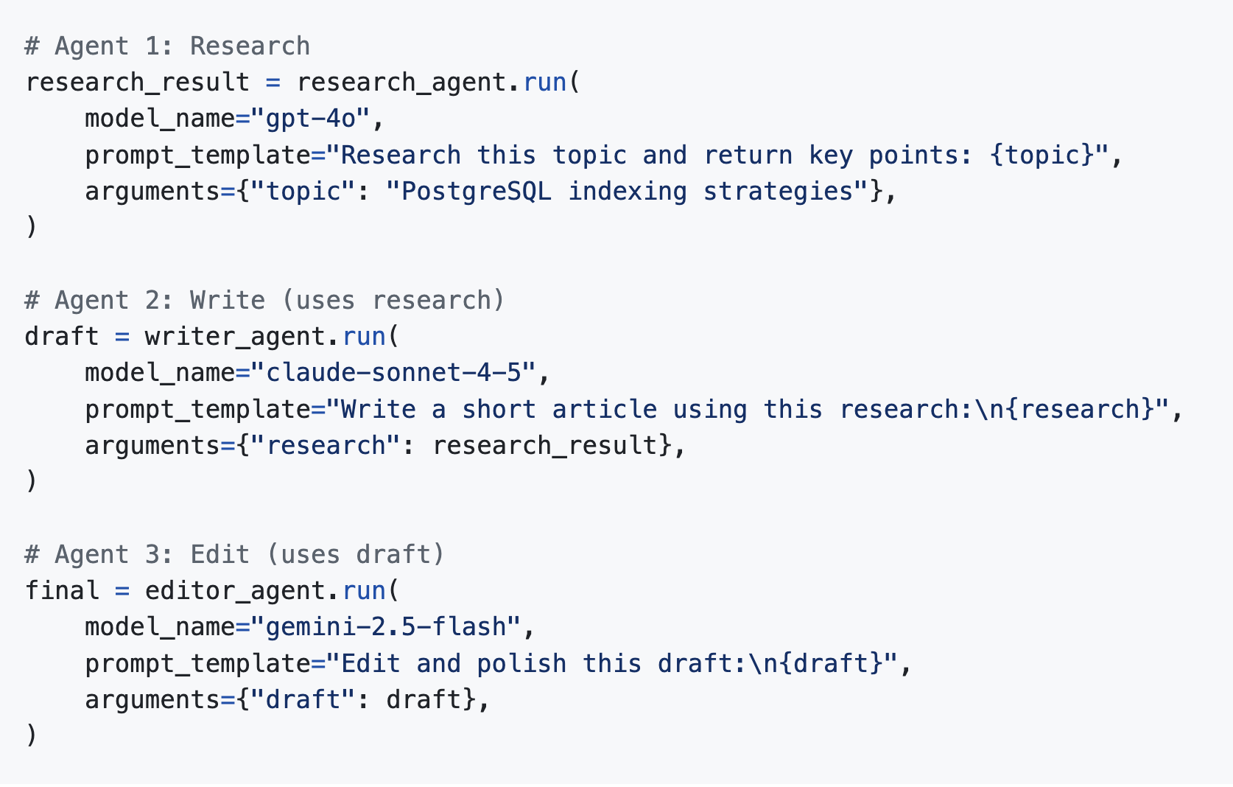
Multi-Agent Orchestration: Python and Agents as Functions

Slide 11
Why Functions Are Powerful
No Complex Orchestration Needed:
Existing frameworks require you to learn a new paradigm:
graphs, workflows, channels, and supervisors.
KISS takes a different approach:
agents are just functions
Each agent can:
Use a different model
Have its own budget
Save its own trajectory
No async/await or anyio
Coding agents make almost no mistake in writing KISSAgents.

Slide 12
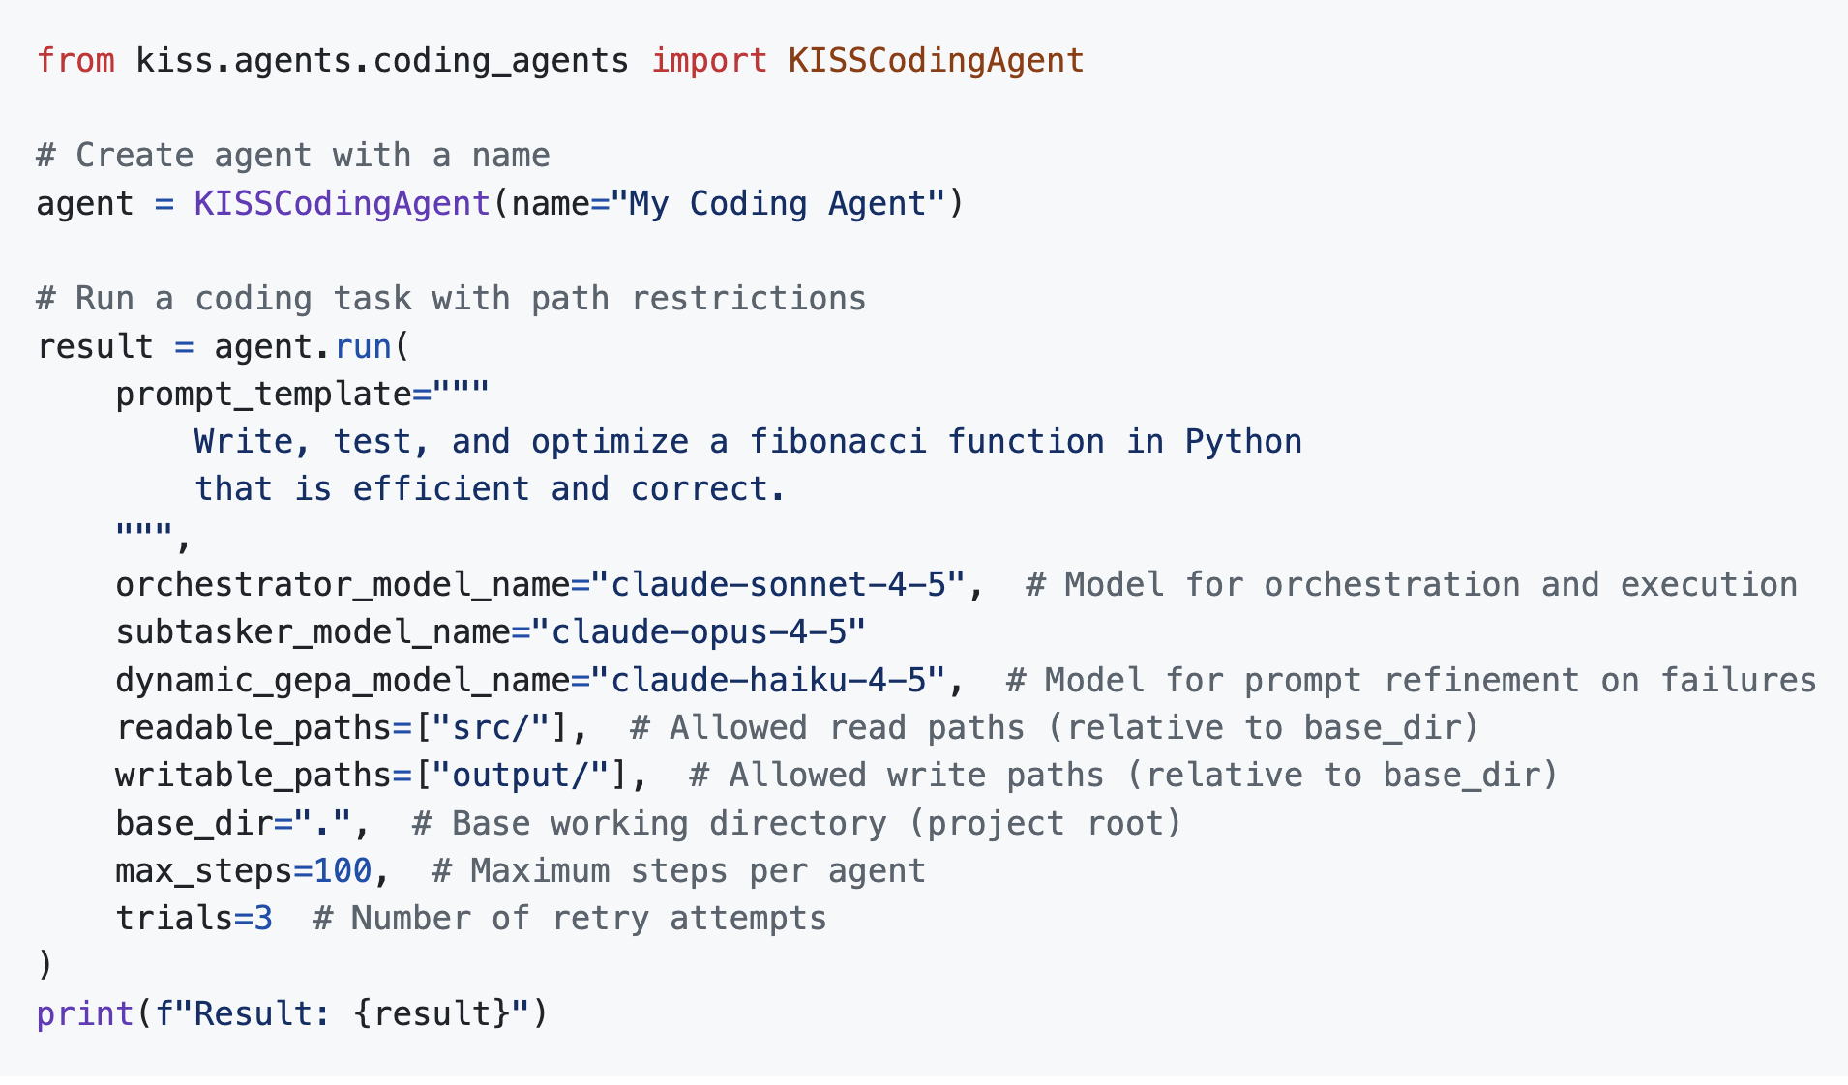
KISSCodingAgent - Multi-Agent Coding

Slide 13
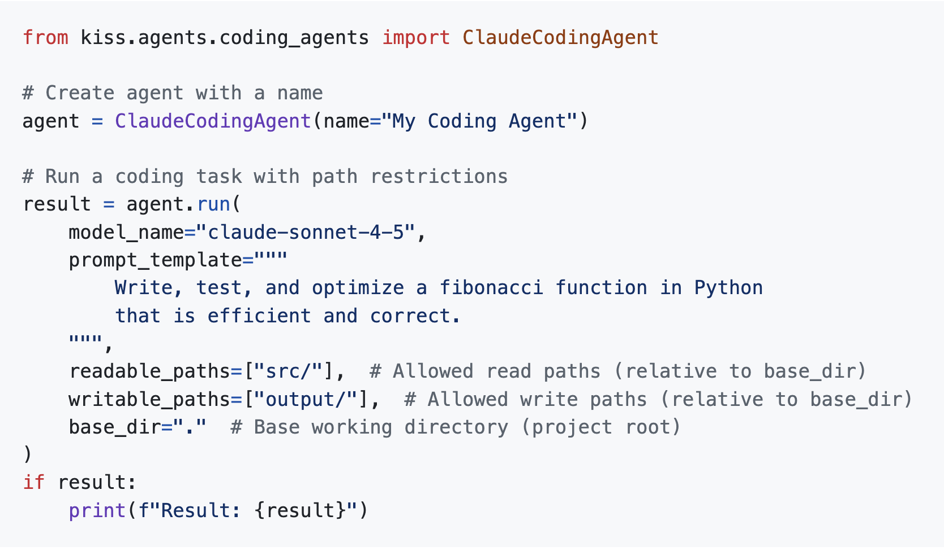
Claude Coding Agent
Claude Code is popular, so KISS provides an implementation of Claude Coding Agent using Anthropic’s Agent SDK

Slide 14
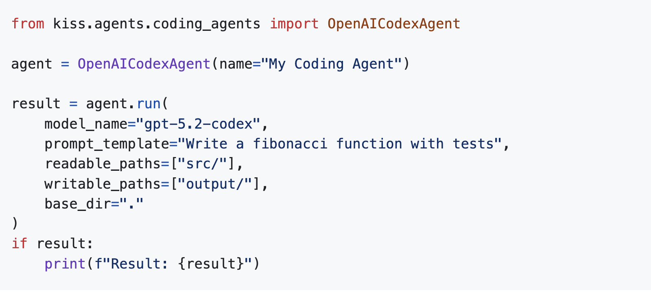
OpenAI Codex

Slide 15
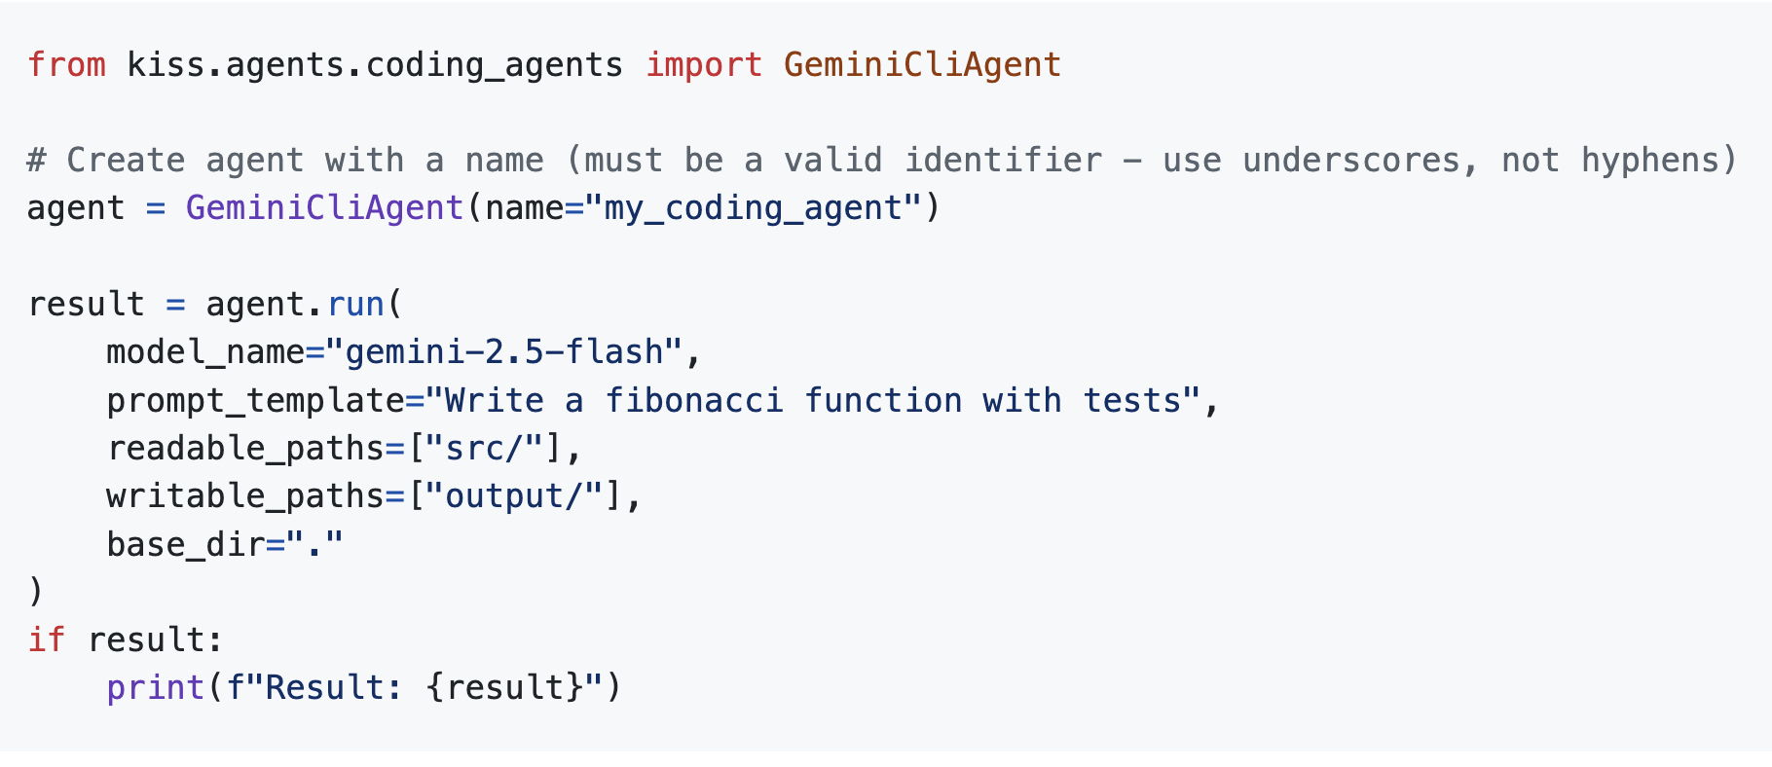
Gemini CLI

Slide 16
GEPA - Genetic-Pareto Prompt Evolution
Based on: "GEPA: Reflective Prompt Evolution Can Outperform Reinforcement Learning"
Key Concepts:
• Dev/Val Split - Prevents overfitting
• Pareto Frontier - Tracks best per instance
• Mutation Gating - Only accept improvements
• Trajectory Reflection - Uses tool calls & reasoning
• Structural Merge - Combine complementary prompts

Slide 17
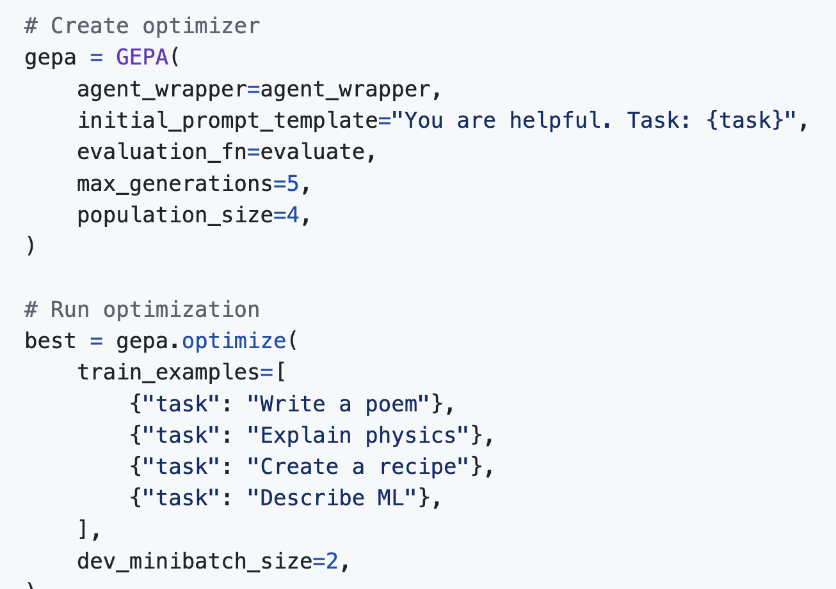
GEPA Quick Start

Slide 18
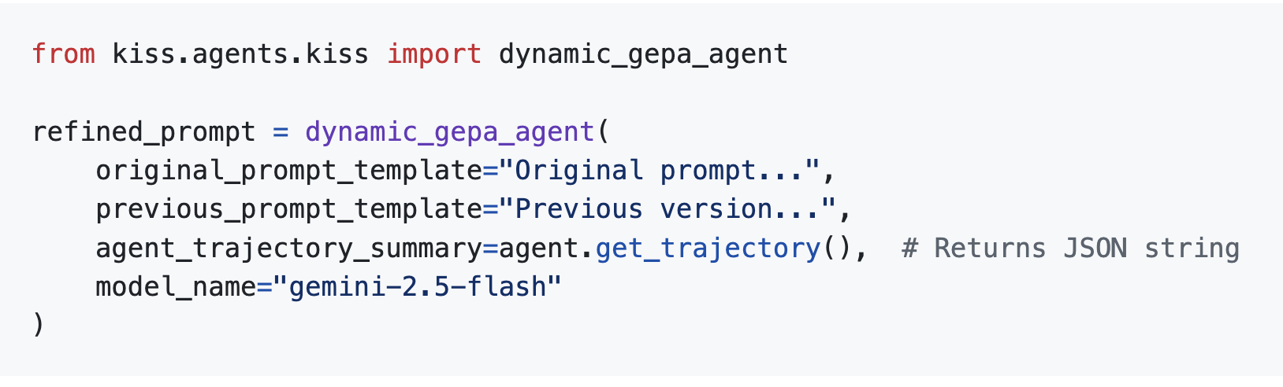
Dynamic GEPA Refinement
Self-Improving Prompts:
When a task fails:
1. Analyze the execution trajectory
2. Refine the prompt
3. Retry with improved instructions

Slide 19
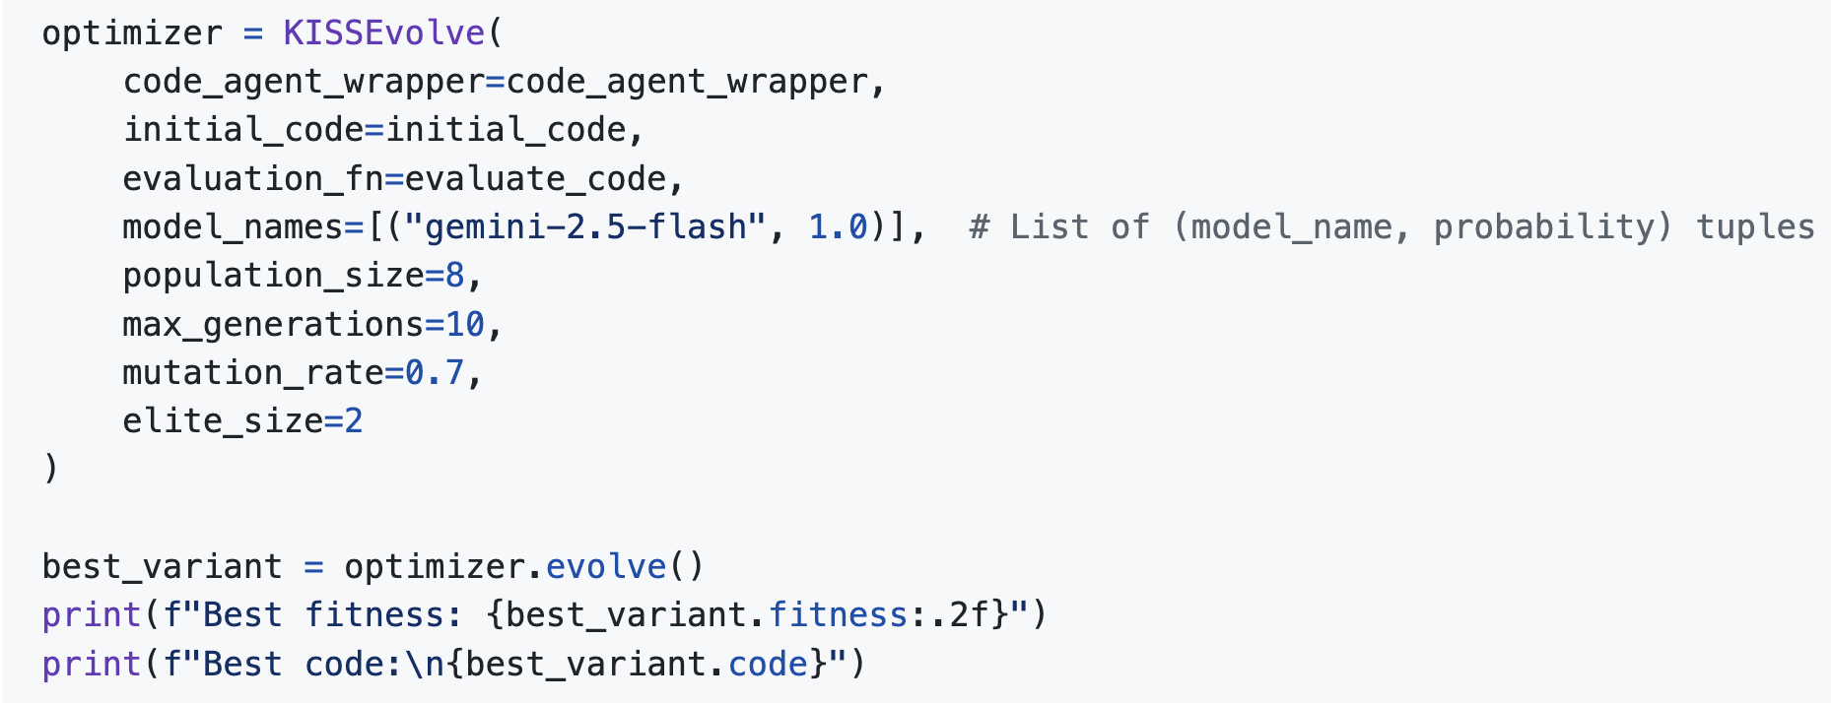
KISSEvolve - Algorithm Discovery

Slide 20
KISSEvolve Features
Core Features:
Semantic aware mutation/crossover
Elite preservation
Multi-model support
Rich evaluation metrics
Advanced Features:
Island-based evolution
Novelty rejection sampling
Power-law sampling
Performance-novelty balance

Slide 21
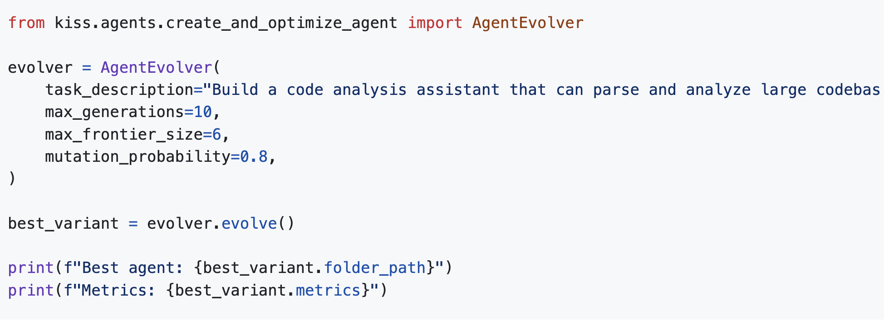
Agent Evolver - Create and Optimize

Slide 22
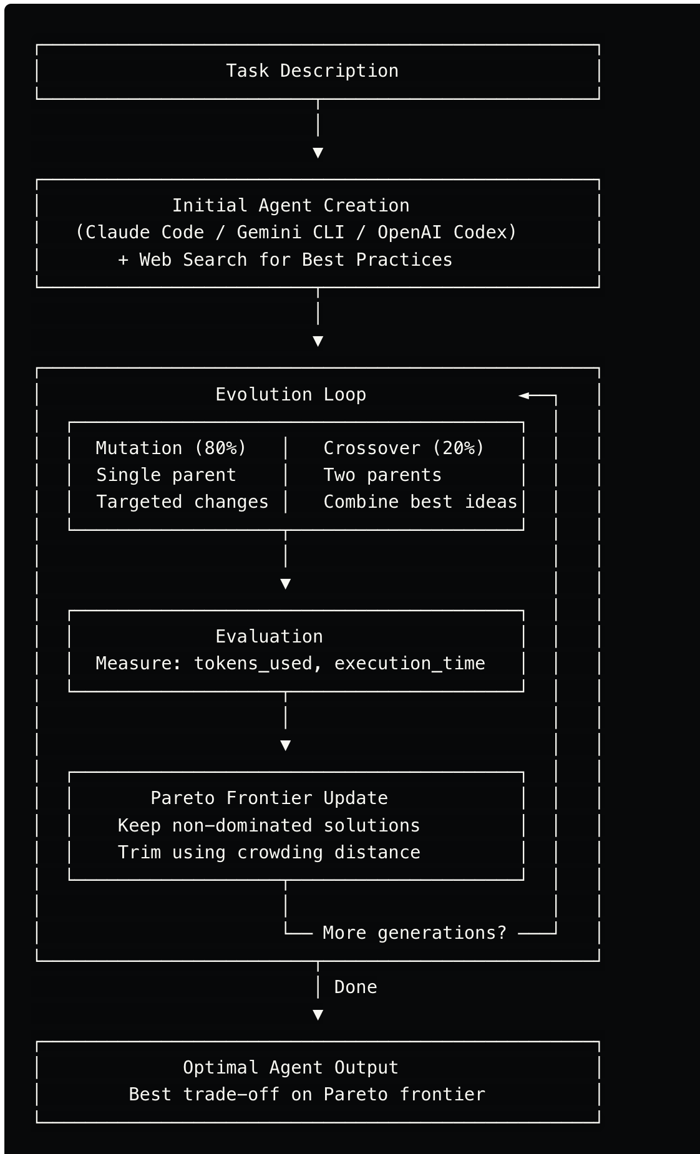
Agent Evolver Architecture

Slide 23
Trajectory Visualization
Web-Based Execution Viewer:
uv run python -m kiss.viz_trajectory.server artifacts
Features:
• Modern UI with dark theme
• Markdown rendering
• Syntax highlighting for code
• Metadata display (tokens, budget, steps)
• Sidebar navigation for all trajectories

Slide 24
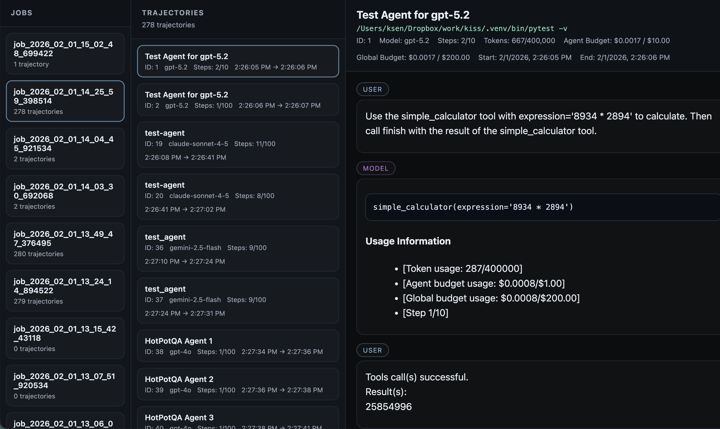

Slide 25
Summary - KISS Philosophy
1. Simplicity over complexity
2. Python functions as the orchestration layer
3. Native function calling - no annotations needed
4. Multi-agent systems that compose naturally
5. Self-improvement and agent optimization
Get Started: https://github.com/ksenxx/kiss_ai/

Slide 26
Thank you
Thank You
Questions?
KISS Agent Framework
https://github.com/ksenxx/kiss_ai

